Slide 1
End-to-End Job Data Analysis, Recommendation, and Resume Customization System
Data Scraping: Rowan
DevOps : Rowan, David, Sam
Gen AI: Kevin
ETL & Reporting: Jasper

Slide 2
00
Introduction and Project Overview
Goal:
To develop an end-to-end automated system that empowers job seekers and analysts by leveraging advanced data processing, AI, and visualization technologies.
Data Lake + Gen AI + Analytics + Visualization
Personalized Job Matching
Customized Resumes and Cover Letters
Job Market Analysis
Seamless User Experience
Interactive Visual Dashboards

Slide 3
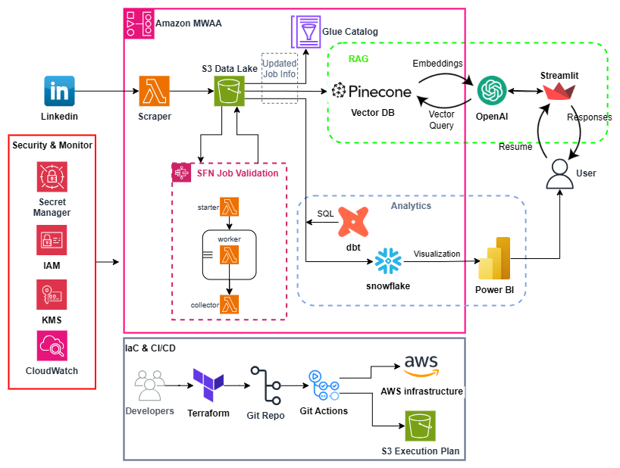
Pipeline
Spark on kubernetes?

Slide 4
Contents
01
02
03
04
05
Data Scraping
Data Storage, Processing & Pipeline Orchestration
Gen AI
Data Transformation & Reporting
CI/CD & IaC

Slide 5
01
Data Scraping

Slide 6
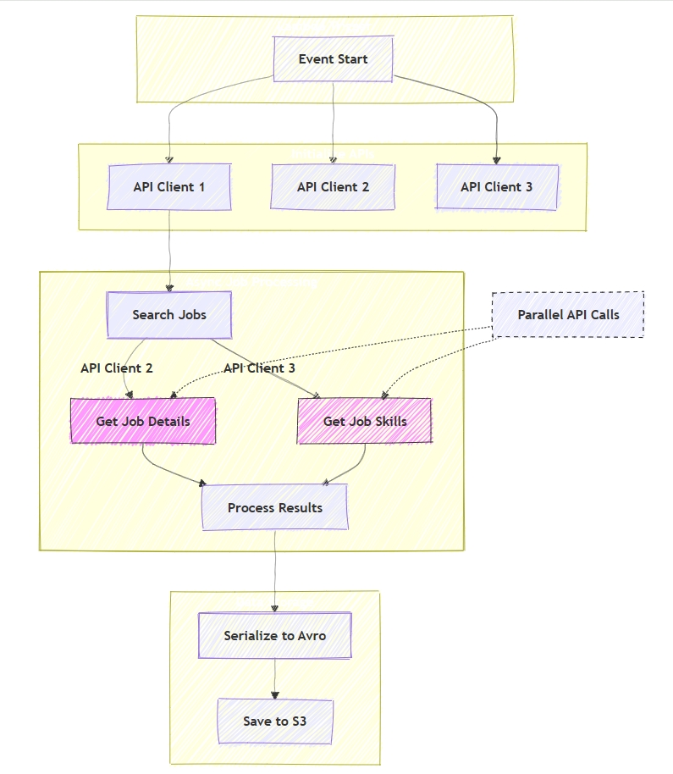
LinkedIn Job Scraper Architecture
Technology Stack
Python-based LinkedIn API
Direct access to LinkedIn's Voyager endpoints
AWS Lambda & S3 for deployment
Key Features
Asynchronous processing using 3 accounts
Rate limit handling & Data deduplication
Data Processing
Job details and skills data extraction
Storage in Avro format
Maintenance Note
Cookie refresh required every 3 months
Stored securely in S3

Slide 7
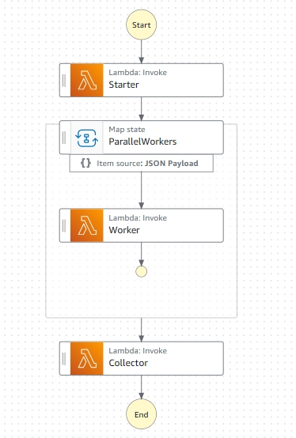
LinkedIn Job Validation
Architecture Overview
Distributed Processing Architecture with AWS Step Functions
Dynamic Worker Allocation
Parallel Job Status Validation
Automated Invalid Job Filtering
Key Benefits of Step Functions
Native AWS Service Integration
Automatic State Management
Effortless to Build

Slide 8
02
Data Lake, Processing & Pipeline Orchestration

Slide 9
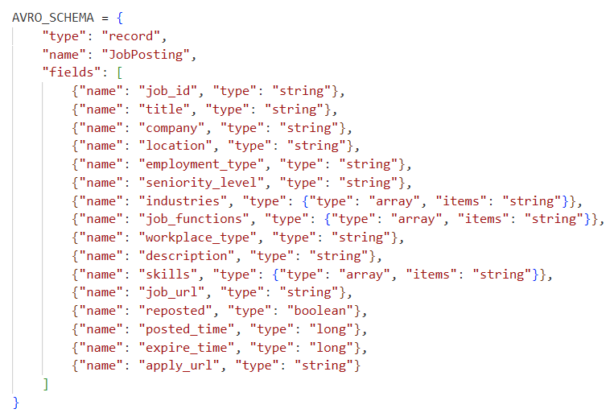
Storage
Storage Architecture
S3 as scalable data lake
Snowflake for data warehousing
Why Avro Format?
Strong support for fields evolution
Store schema with data
Built-in schema validation
Efficient binary compression

Slide 10
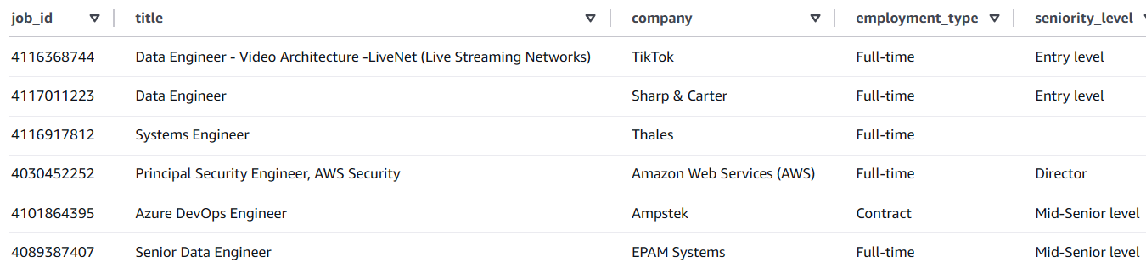
Glue Catalog
Table Configuration
External table for Avro data
Partitioned by year/month/day/keyword
Managed through Terraform
Crawler Features
Automated metadata updates
S3 encryption enabled
Schema change logging
Benefits
Centralized metadata • Efficient querying • Infrastructure as code

Slide 11

Data Processing
AWS Lambda
LinkedIn data extraction via Python
Data storage in Avro format
15-minute timeout sufficient
Automatic scaling
Benefits
Serverless • Cost-efficient • Scalable

Slide 12


Pipeline Orchestration
Orchestration – Automation of daily tasks
pipeline is triggered everyday to scrap jobs posted in the last 24 hours
Airflow
Comprehensive Workflow Management & Flexibility
Robust Monitoring & Error Handling
Integration with wide range of services
Step Function
AWS native service for workflow orchestration
Limited to AWS services primarily, less flexible for non-AWS tasks

Slide 13
Why Include Step Functions Within Airflow?
Problem statement: During the job validation step, we need to split the workload and invoke a dynamic number of Lambdas to call the LinkedIn API from different IPs, avoiding being blocked.
Challenges with Airflow:
Static Nature of DAGs: Airflow DAGs are predefined and static. Adjusting workflows dynamically is possible but requires workarounds that are not elegant.
Limitations of LambdaInvokeFunctionOperator: Not Deferrable
Synchronous Invocation: Blocks Airflow workers while waiting (up to 15 minutes until Lambda timeout).
Asynchronous Invocation: Cannot track Lambda execution status, leaving success/failure unknown.
Advantages of AWS Step Functions:
Dynamic Workflow Support:
The first Lambda outputs the number of subsequent Lambdas required.
Step Functions orchestrate and dynamically invoke these Lambdas, managing execution statuses seamlessly.
Deferrable in Airflow:
Using the StepFunctionStartExecutionOperator in Airflow avoids occupying workers while waiting for Step Functions to complete. This enhances resource efficiency and scalability.

Slide 14
Airflow DAGs
Demonstration in MWAA UI
1d419daf-46dd-4d52-9e7d-c8fe4633b6f1.c7.ap-southeast-2.airflow.amazonaws.com

Slide 15
Security:
MWAA
Login: Users authenticate to MWAA through AWS credentials, with optional Multi-Factor Authentication (MFA) for enhanced security.
User Roles: Permissions and roles within Airflow are managed using AWS IAM policies.
Authorization: Access to AWS services is managed through the MWAA execution role, which defines the actions Airflow is allowed to perform on AWS resources.
Within airflow
Data Encryption in Airflow:
Configured AIRFLOW__CORE__FERNET_KEY to encrypt sensitive data such as variables, connections, and XComs within Airflow, ensuring confidentiality.
AWS Secrets Manager as Secret Backend:
Integrated AWS Secrets Manager as the secret backend for Airflow to securely store and manage sensitive information like secrets, API keys, and connection details.
Enables Airflow to securely access third-party services, such as:
Gmail: For sending notification emails,
OpenAI and Pinecone: For injecting new jobs and removing invalid jobs from the vector database,
Snowflake: For extracting data and loading it into the data warehouse.

Slide 16
03
Gen AI

Slide 17
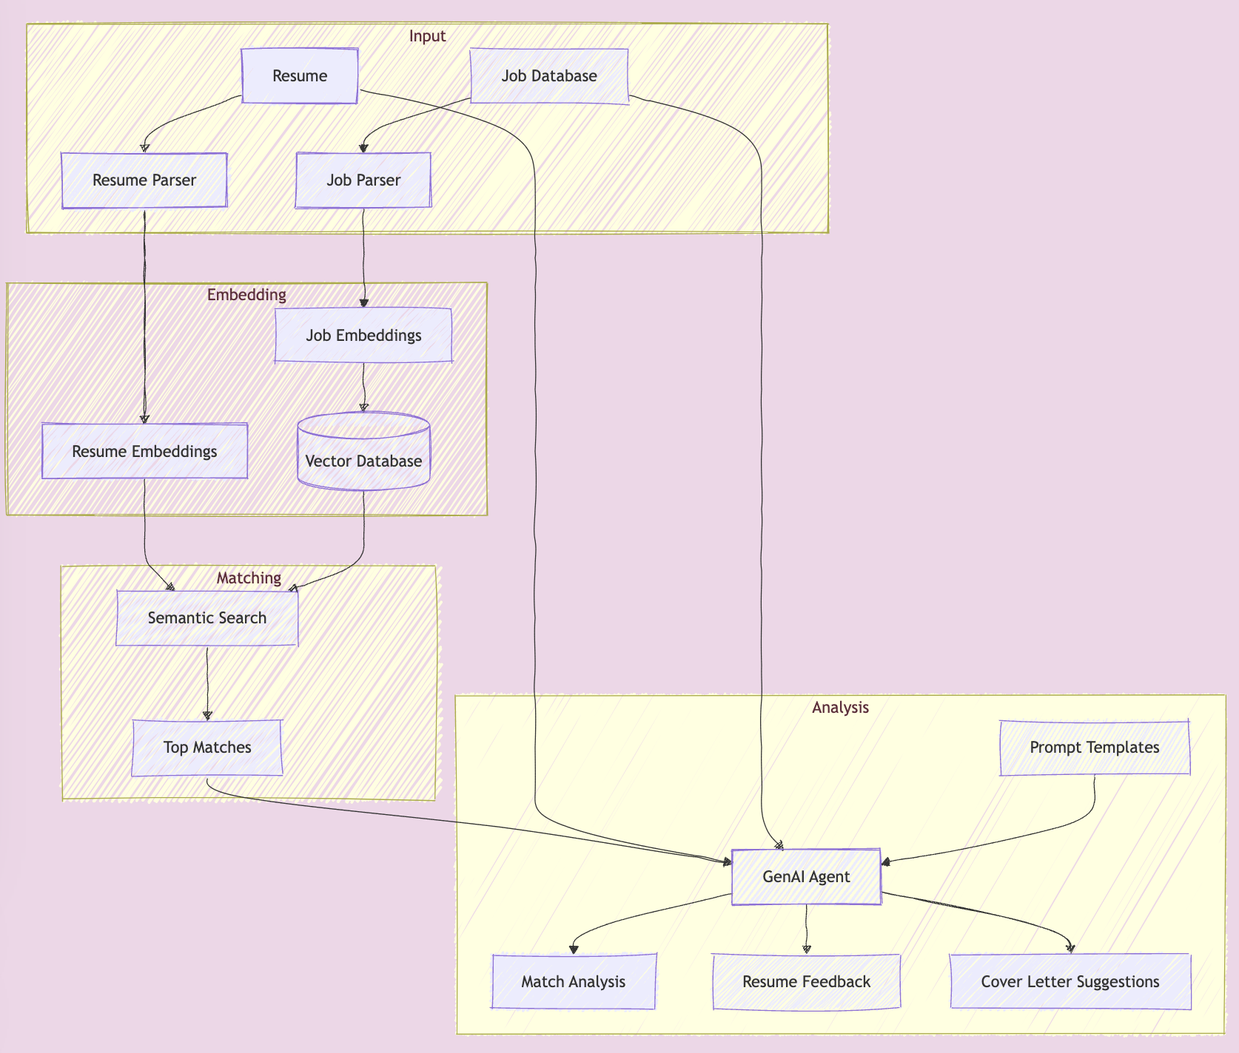
AI powered job hunting
Key steps
Retrieval
Embedding
Generation
Analysis
Evaluation
Key features
Intelligent job matching
Resume analysis and feedback
Cover letter generation & support

Slide 18
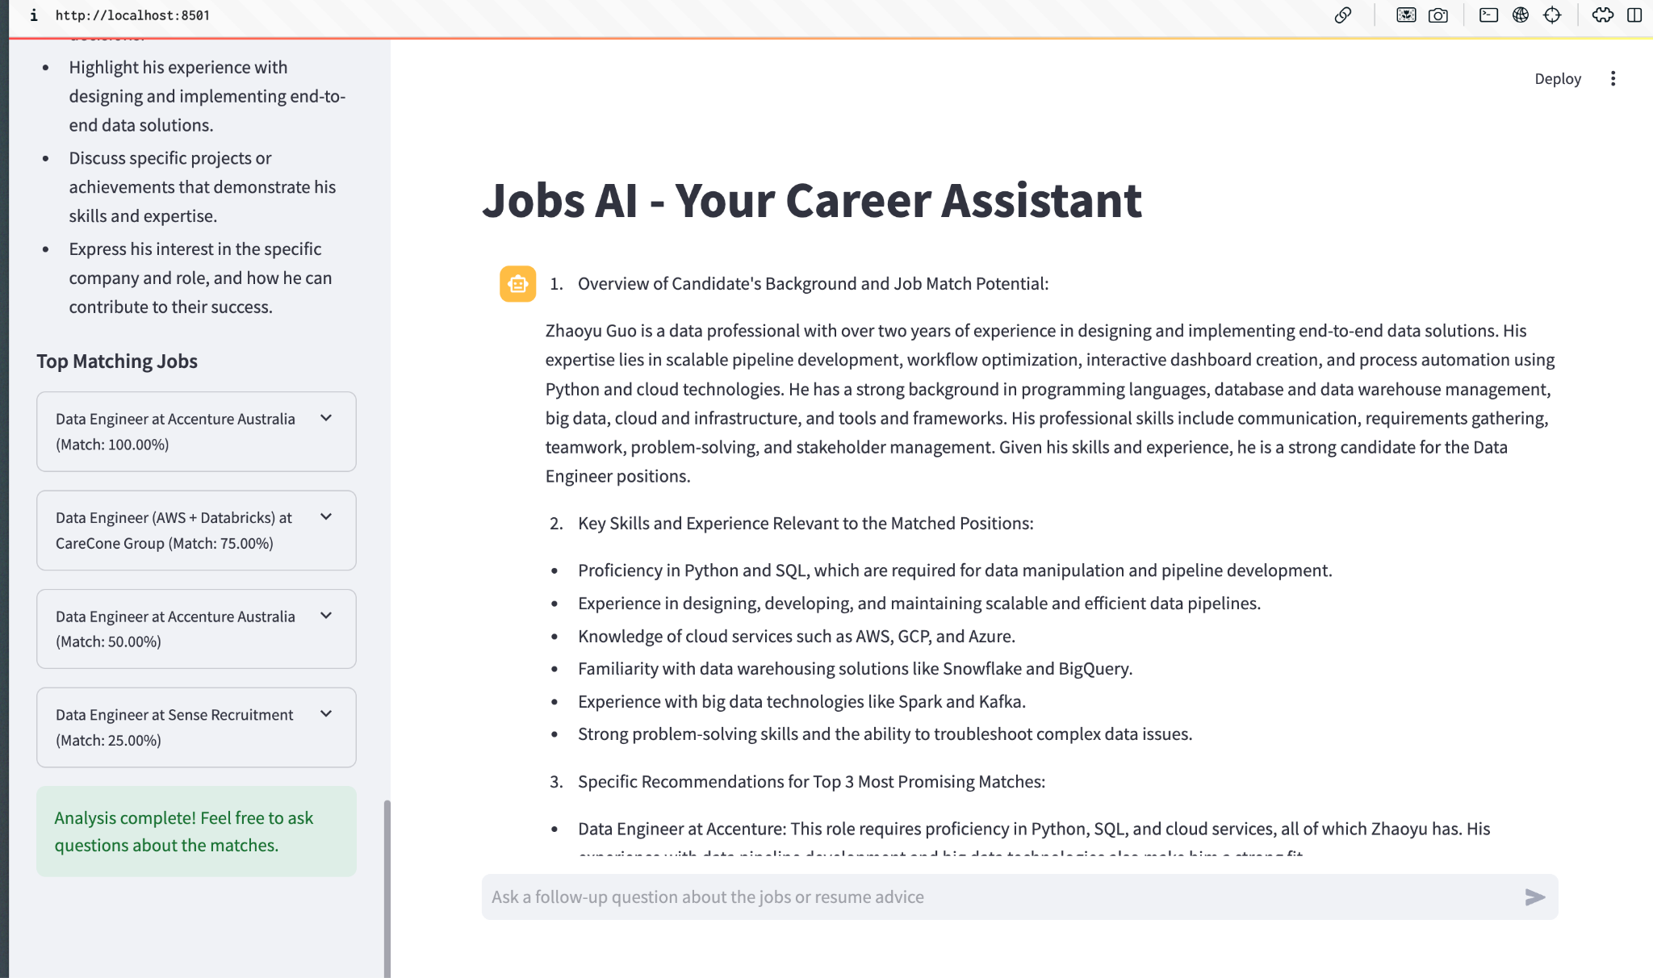

Slide 19
04
Data Transformation & Reporting

Slide 20
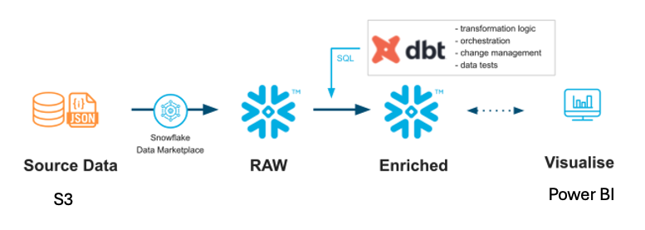
ELT pipeline
Snowflake handles data storage and compute:
Stores raw data from sources (S3, JSON, AVRO)
Manages data marketplace access
Provides scalable compute for transformations
DBT manages transformation layer:
Handles SQL transformations
Orchestrates data flows
Implements testing
Manages version control
Documents data lineage

Slide 21
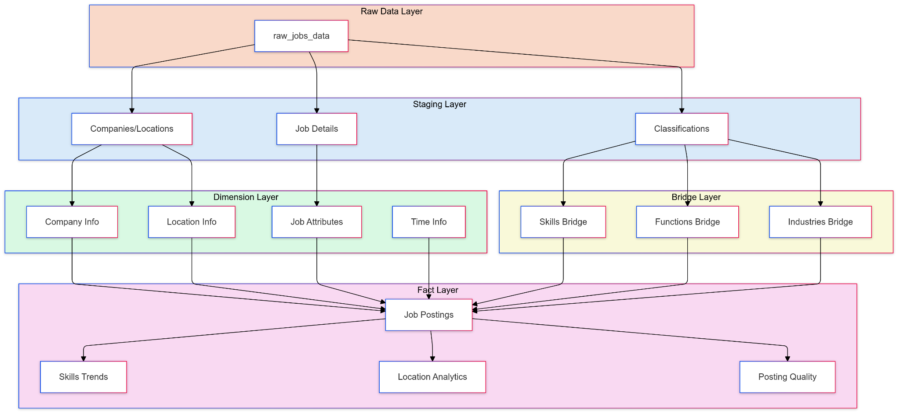
Data Transform using DBT

Slide 22
Kimball’s dimensional modeling
Fact Tables:
1. Main fact_job_postings:
One row per unique job posting ID
Links to all dimensions via surrogate keys
2. Analytical fact tables:
skill_trends
location_analytics
posting_quality
Dimension Design:
Company: Basic dimension with company metrics
Location: Hierarchy (Country -> Region -> State -> City) + workplace type
Employment: Type and seniority level standardization
Time: Date dimension with year, month, quarter
Bridge tables for many-to-many relationships:
job_skills
job_functions
job_industries

Slide 23
Visualization using Power BI
skill demand trends, hiring patterns by industry, location-based job insights, …
Power BI is preferred over Tableau
Seamless integration with Excel, Azure and Microsoft 365 suite
Direct connection to Excel / SharePoint data
Data modelling capability and strong DAX language for complex calculations
Extensive Power Query capabilities for data transformation
Version control support (on Power BI Server)

Slide 24
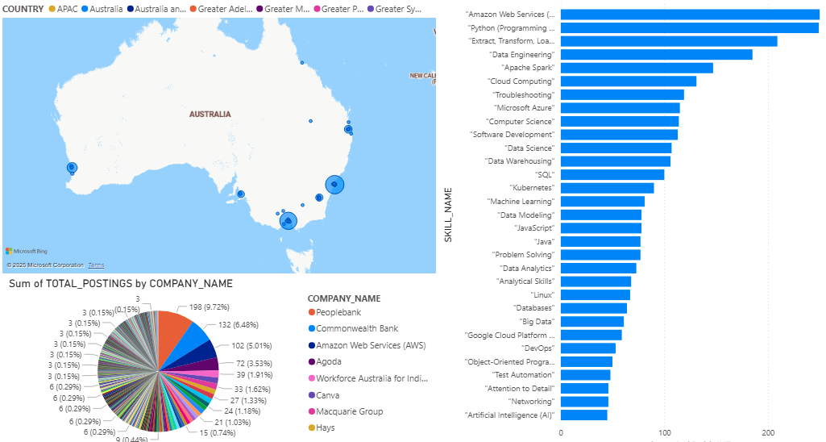
Visualization using Power BI

Slide 25
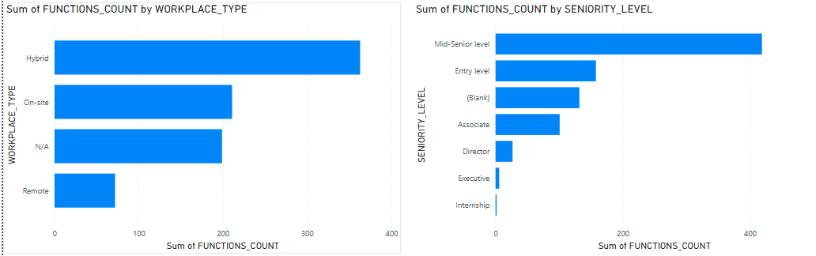
Visualization using Power BI

Slide 26

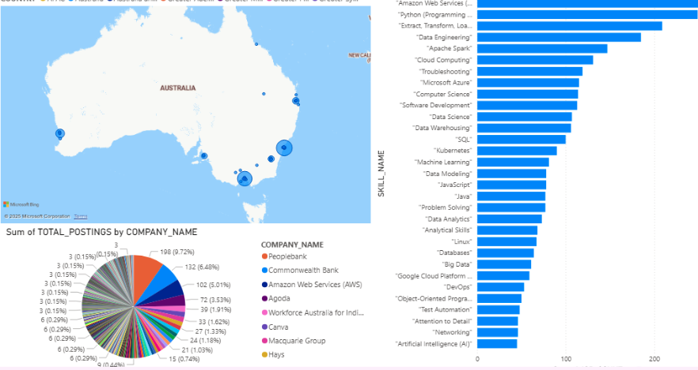
ELT pipeline

Slide 27
05
DevOps & Project Management

Slide 28
DevOps
Terraform for Infrastructure as Code
GitHub for version control and GitHub Actions for CI/CD
Airflow for workflow orchestration and monitoring
CloudWatch for infrastructure and application monitoring

Slide 29

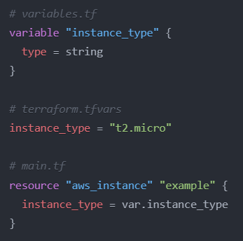
IaC
Terraform
Infrastructure as Code (IaC) automation
Multi-cloud support
Version-controlled infrastructure
Consistent environments
Easy to code & Reduced human error
Advantages over CloudFormation
Provider-agnostic (not AWS-only)
HCL syntax (more readable than JSON/YAML)
State management capabilities
Faster deployment execution
Better dependency handling

Slide 30
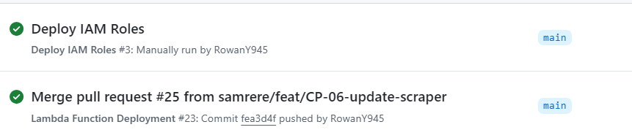
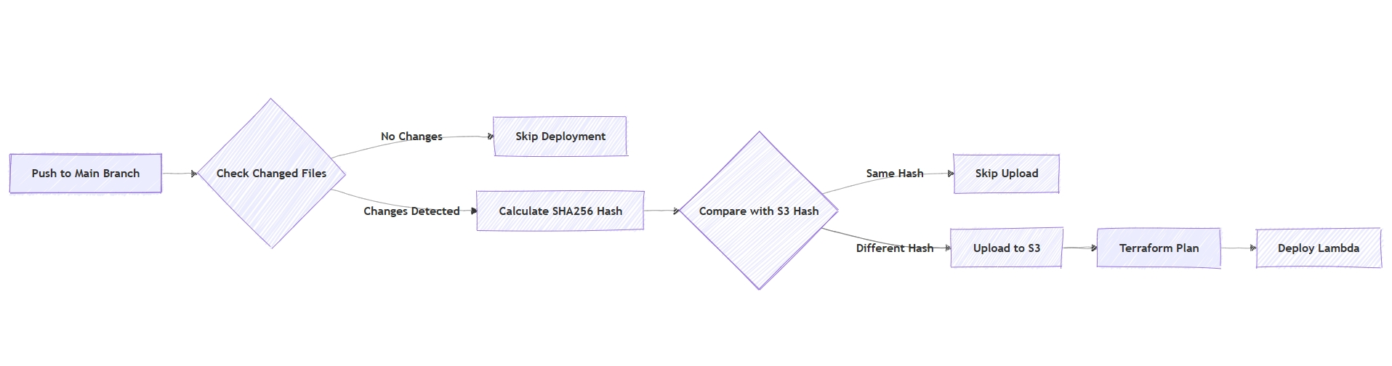
CI/CD: GitHub Action
Lambda Function Depolyment

Slide 31
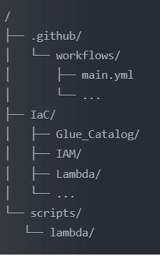
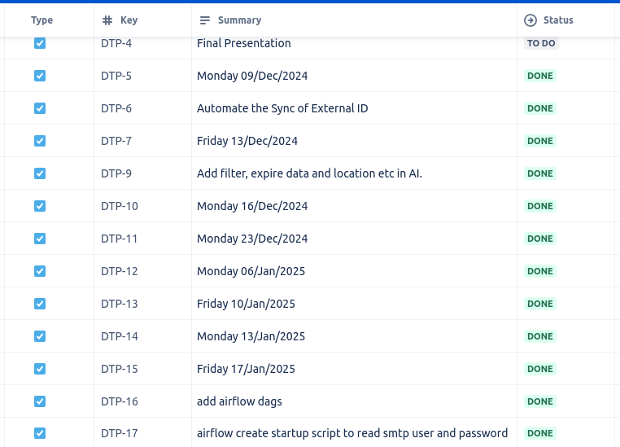
Code repo and Project Management
Github for code repo and CI/CD
Scraper code and IaC
Data Modeling (dbt models)
RAG
Orchestration (Airflow dags)
JIRA for Planning and Task Management
Confluence for documentation, knowledge management, and collaboration

Slide 32

Thanks!

